Slide 1


Slide 2


Slide 3
The Joy of Giving
“In a situation where there are islands of abundance in the sea of poverty, let us join hands to make this world a better place to live.”

Slide 4
The Joy of Giving
Sankalp organized a donation event at Mohan Nagar area, Adityapur
Books, unused and new stationery were distributed to needy children
Clothes (summer and winter) which were donated by students of NIT Jamshedpur and our well wishers from across the city (Spouses of Tata Steel employees) were distributed to the children and their parents
The event takes place regularly where we intend to take out the surplus from the society and distribute it to the needy ones.

Slide 5
Books, Stationery and Clothes donation event at Mohan Nagar, Adityapur

Slide 6


Slide 7
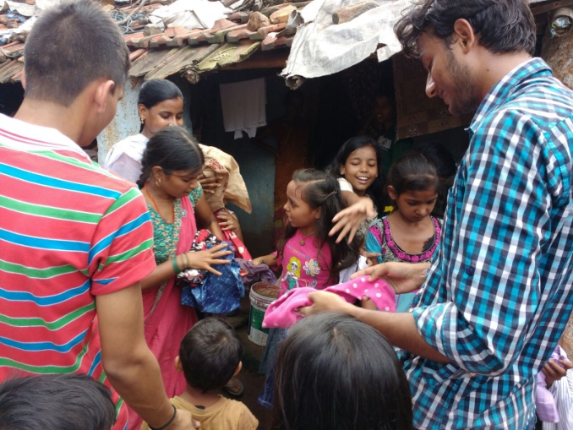
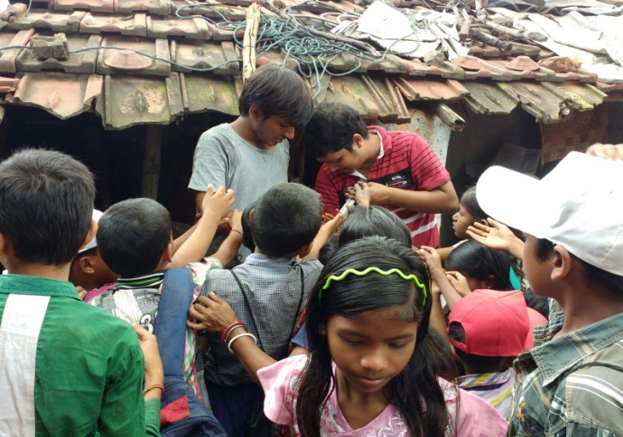
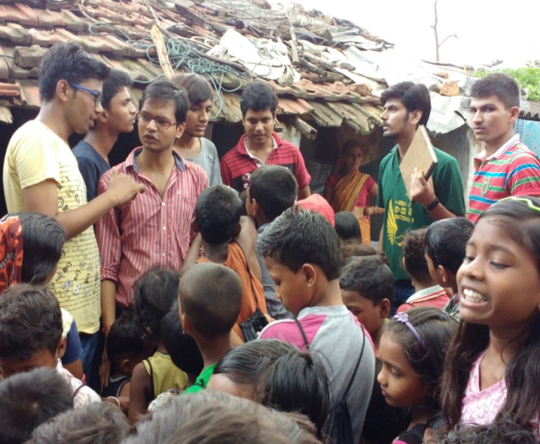
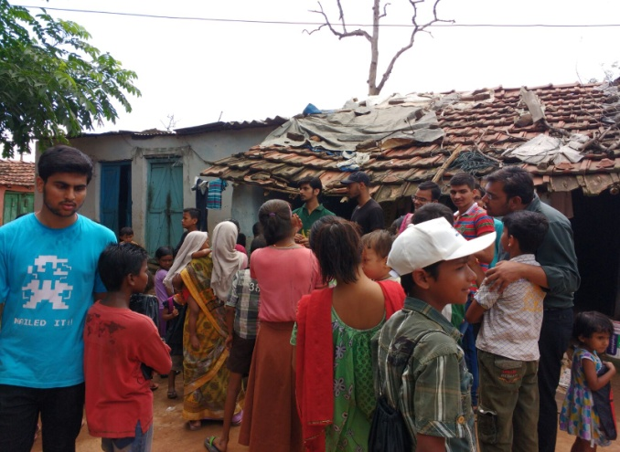
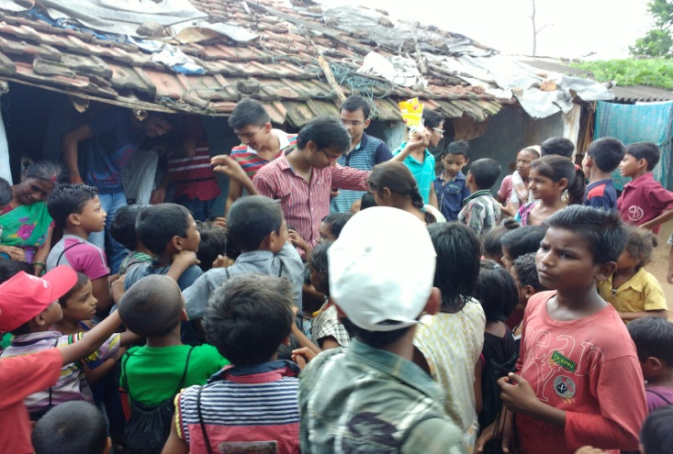
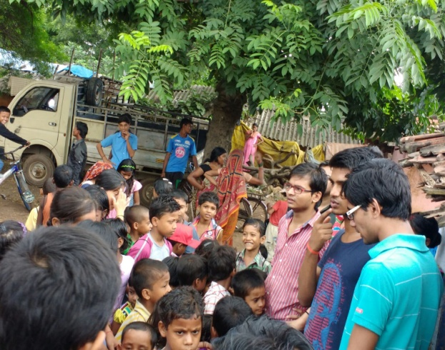
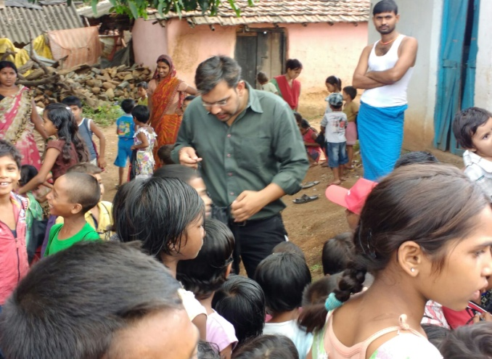
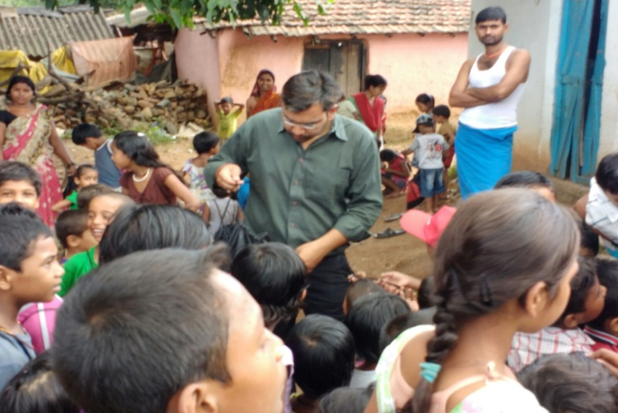
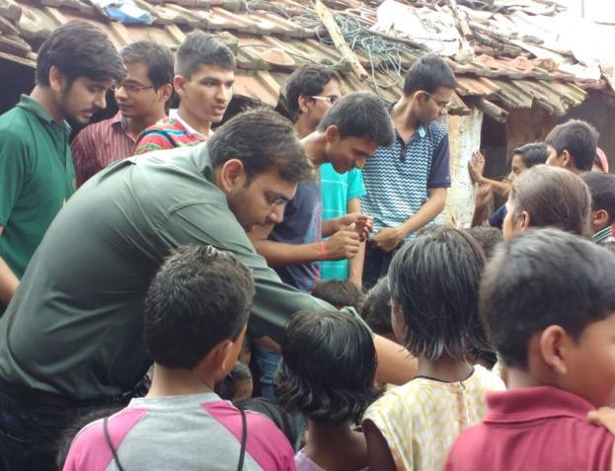

Slide 8

Come let’s be a part of the noble mission called
The Joy of Giving because

Slide 9
EASY WAY TO DONATE NOW
You can donate at any our centres by just making a call to Sankalp-A Pledge to Change volunteers.
All our centres are Adityapur based and run 6 days a week
You may donate books from
  Class 1-8- Course Text Books (Any Board)
  Story Books
  Unused stationery
  Any other items like bag, toys, uniforms etc.
Relevant Contact Nos. Are
  Subodh Kumar Das-9798756336
  Mayank Aggarwal -9031975746
  Suresh Pareek -7209632032
  Vikas Dixit -9472706225

Slide 10
ACCOUNT DETAILS FOR SUPPORT
Sankalp Account Details
  You can transfer funds online into our account:-
  “SANKALP” A/C No.-31114719936
  CIF No: 85757412911
  IFSC Code: SBIN0001882
  MICR Code: 831002004
  Branch code: (1882)
  Branch: SBI- RIT JAMSHEDPUR
    You may also visit our website and pay through online link available over it.
www.sankalpnitjamshedpur.org

Slide 11
“You have not lived today until you have done something for someone who can never repay you.”
Thank You
www.sankalpnitjamshedpur.org

